Slide 1
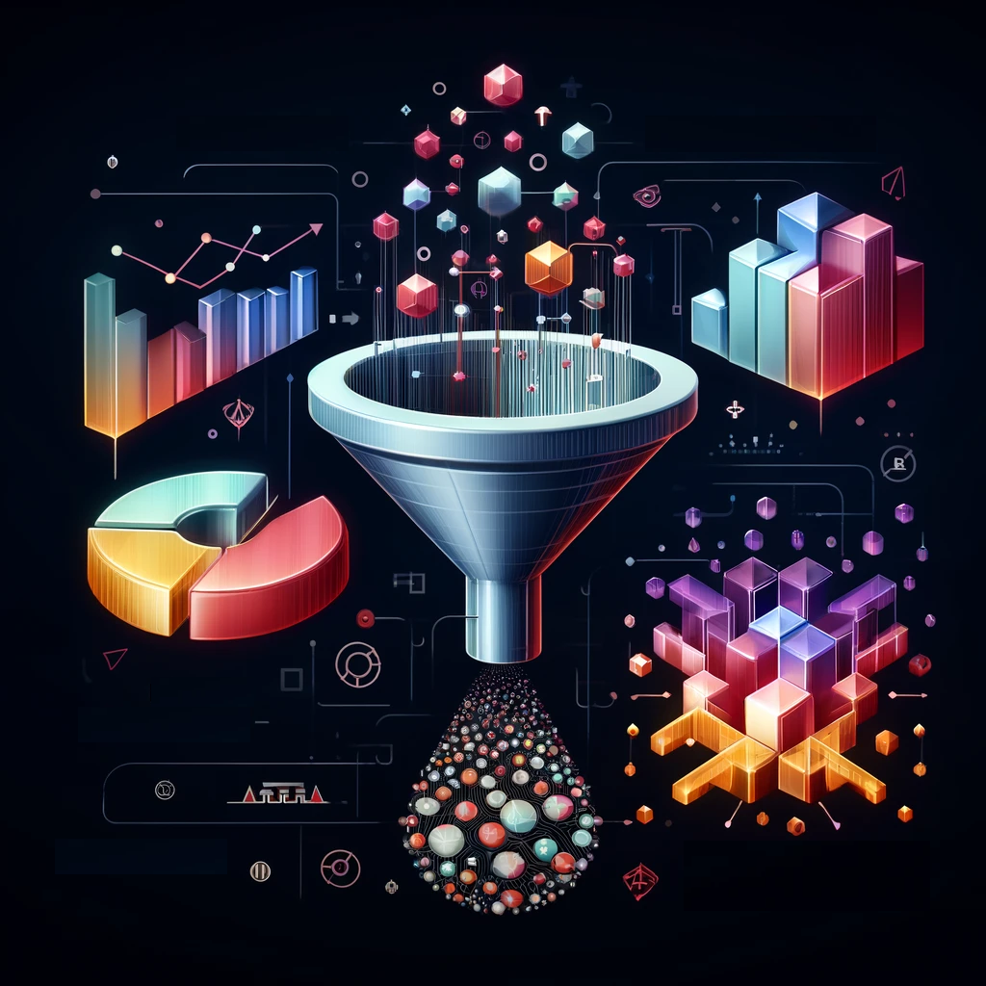
A Unified Anomaly Synthesis Strategy with Gradient Ascent for Industrial Anomaly Detection and Localization
Paper review
Gibeom Kim (UST)

Slide 2
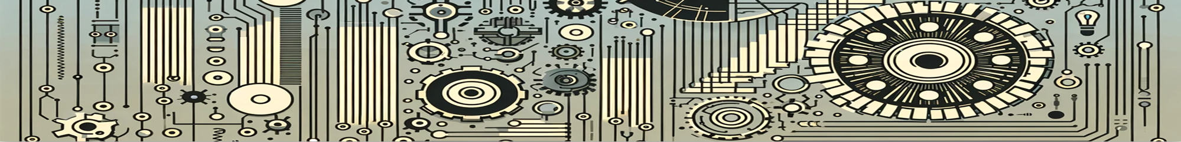
Index
Paper abstract
Model
Conclusion

Slide 3
1. Paper abstract
GLASS is proposed for detecting weak defect
Global Anomaly Synthesis (GAS) at the feature level
Local Anomaly Synthesis (LAS) at the image level
Use these two synthesis strategy to address weak defect
Trains on this wide range of synthetic anomalies to achieve SOTA results on MVTec AD, VisA, MPDD benchmark

Slide 4
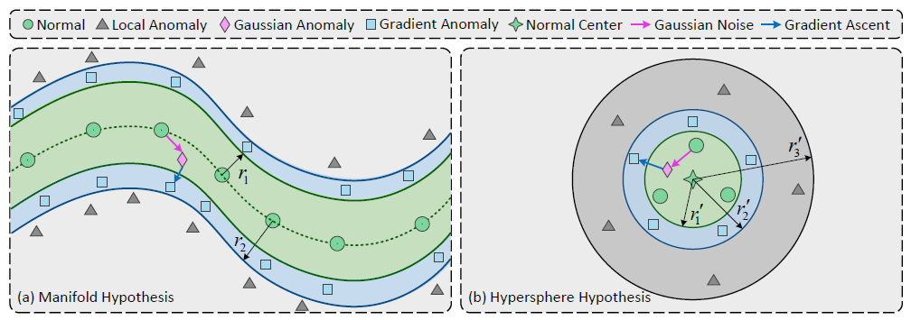
2. Model
Manifold Hypothesis
Hypersphere Hypothesis
Notes:
In low dimensions, the normal feature can be represented in Euclidean space as linear combinations, as shown in the figure on the left, representing the overall nonlinear distribution.
It also assume that the combination of normal feature points is contained inside a single compact circle, as shown in the figure on the right.

Slide 5


2. Model

Slide 6


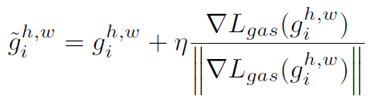
2. Model
Notes:
무작정 노이즈를 더하는 Gaussian anomaly 단계
그 노이즈 벡터를 출발점 삼아,
손실을 최대화하는 방향(∇L_{gas})으로
일정한 크기(η)만큼 이동(=gradient ascent)

Slide 7

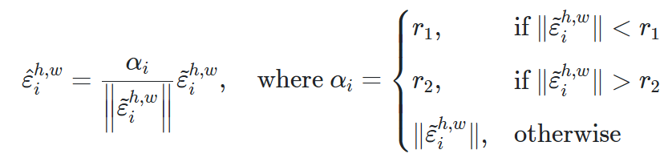
2. Model
Truncated Projection

Slide 8
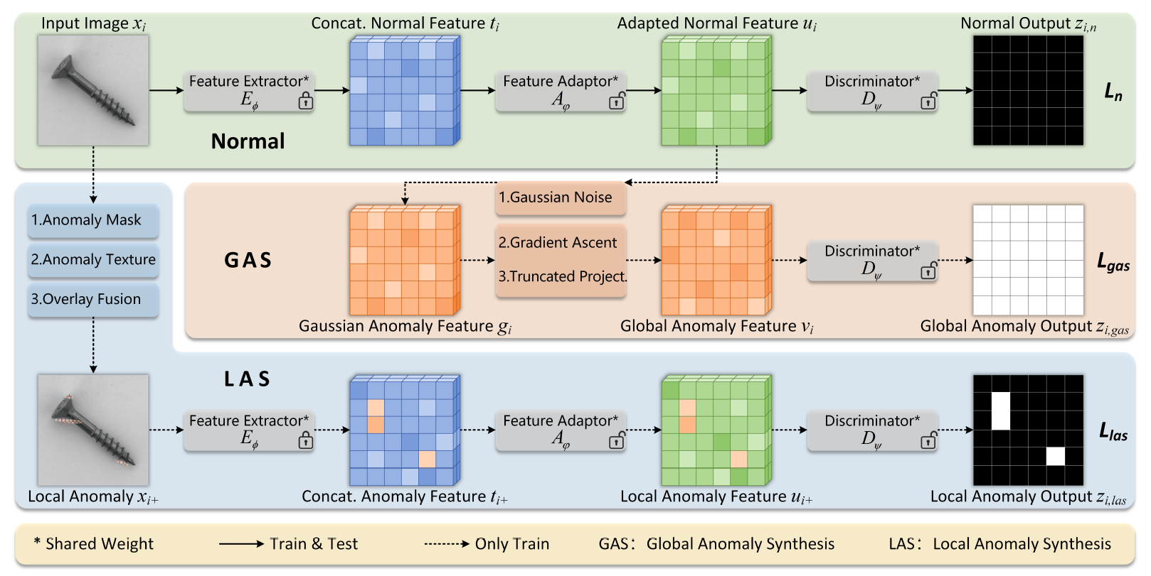
2. Model

Slide 9
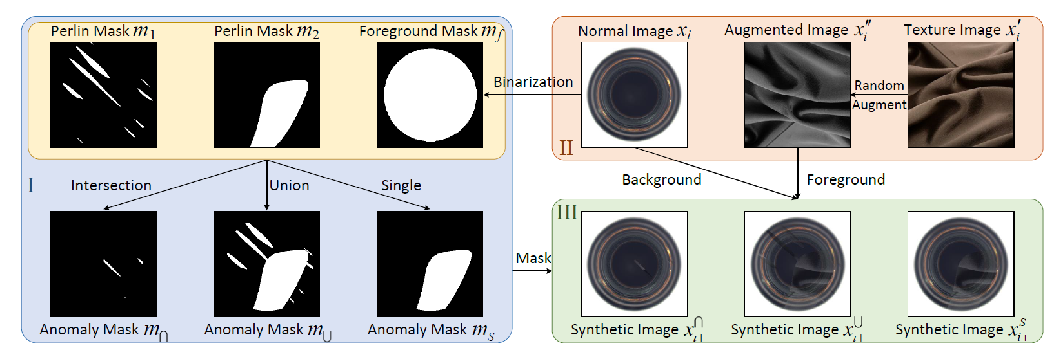
2. Model
Notes:
Step I:Anomaly Mask, Step II: Anomaly Texture, and Step III: Overlay Fusion.

Slide 10
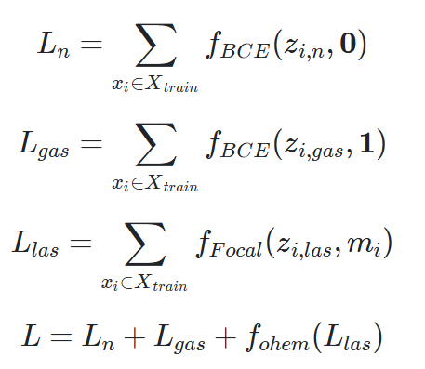
2. Model
BCE to L_n and L_gas
Focal loss to L_las
Sum all of losses to make total loss L
Notes:
For a Normal image, 0 is the correct answer mask for all pixels because there are no bad pixels.
GAS applies Gaussian noise and gradient multiplication over the entire range, so all pixels are bad, so 1 is the answer mask.
LAS puts the anomaly mask as the correct answer mask because the only bad pixels are where the anomaly mask is applied.

Slide 11
3. Conclusion
Integrates image-level (LAS) and feature-level (GAS) synthesis to cover anomalies from “weak” to “strong.”
Employs gradient-ascent-based Global Anomaly Synthesis to effectively generate subtle defects near the normal data boundary.
Achieves state-of-the-art results on MVTec AD, VisA, MPDD benchmarks and demonstrates real-world applicability.

Slide 12
Thank you

